Slide 1

Metalanguage as an Interdisciplinary Classifier for Mathematics and Computer Science Fields
24-2-R-10
Students: Alex Pitkin 333879013 & Ilya Vorotyntsev 324755735
Supervisors: Elena Kramer & Dr. Dan Lemberg
Notes:
Good afternoon, everyone. Thank you for joining us today as we present our capstone project, "Metalanguage as an Interdisciplinary Classifier for Mathematics and Computer Science Fields." I'm Alex, and this is my partner, Ilya. Together, we've explored how language patterns differ in educational texts from Math and Computer Science.

Slide 2
Agenda
Introduction
Motivation
Problem Statement
Main Goal
Completed Work
Dataset Collection
Text Preprocessing
Text Classification
Text Clustering
Results & Insights
Challenges & Future Work
Q&A

Slide 3
1. Introduction

Slide 4

Why we choose this project?
Did you know that many students excel in computer science but struggle with mathematics, or vice versa?
Many students struggle differently in mathematics and computer science.
Although Math and CS both rely on logic and problem-solving skills, students often find one subject more challenging than the other. This suggests that there are unique aspects in how these subjects are taught and understood.
Notes:
Our motivation came from observing how students, including ourselves, often excel in one subject but struggle with the other. Even though both fields rely on logic and problem-solving, we wondered if the language used to teach these subjects—their metalanguage—plays a role in this difference.

Slide 5
State-of-Art
Can we understand a subject without its specific vocabulary?
Conventional text classification relies heavily on subject-specific terms.
Traditional models focus on keywords unique to each field, like "algorithm" in computer science or "integral" in mathematics. This reliance can limit the ability to generalize across different subjects.
Such approach overlooks deeper linguistic structures common across fields.
By concentrating on terminology, we miss out on analyzing the way ideas are expressed—the syntax, sentence structure, and function words that form the backbone of language in educational texts.
There's a need to classify texts based on general language patterns (metalanguage) rather than terminology.
Exploring the metalanguage allows us to understand how concepts are communicated, independent of specific jargon, revealing insights into teaching methods and cognitive processes involved in learning.
Our goal is to identify these patterns to distinguish between fields in math and CS.
By identifying subtle linguistic differences, we aim to accurately classify texts and ultimately contribute to personalized education by adapting materials to individual learning styles.
Notes:
Traditional text classification models focus heavily on subject-specific terms like "algorithm" in CS or "integral" in Math.
By concentrating on terminology, we miss out on analyzing the way ideas are expressed—the syntax, sentence structure, and function words that form the backbone of language in educational texts.

Slide 6
Our Approach
Can we understand a subject without its specific vocabulary?
Conventional text classification relies heavily on subject-specific terms.
Traditional models focus on keywords unique to each field, like "algorithm" in computer science or "integral" in mathematics. This reliance can limit the ability to generalize across different subjects.
There's a need to classify texts based on general language patterns (metalanguage) rather than terminology.
Exploring the metalanguage allows us to understand how concepts are communicated, independent of specific jargon, revealing insights into teaching methods and cognitive processes involved in learning.
Our goal is to identify these patterns to distinguish between fields in math and CS.
By identifying subtle linguistic differences, we aim to accurately classify texts and ultimately contribute to personalized education by adapting materials to individual learning styles.
Such approach overlooks deeper linguistic structures common across fields.
By concentrating on terminology, we miss out on analyzing the way ideas are expressed—the syntax, sentence structure, and function words that form the backbone of language in educational texts.
Notes:
But we wanted to go beyond that. Our question was: Can we classify texts even when we remove all the subject-specific vocabulary?
We aimed to identify deeper patterns, like syntax, grammar, and general vocabulary—what we call metalanguage. If we can distinguish texts based solely on these patterns, it could lead to new ways of understanding how subjects are taught and learned.

Slide 7
Explore the Existence of a Similar Metalanguages Across Fields
Identify Shared Linguistic Structures
We seek to uncover the common ways in which concepts are communicated across different subjects, focusing on syntax, grammar, and general vocabulary.
Assess the Potential for Cross-Disciplinary Teaching Tools
If a common metalanguage exists, it could inform the development of educational resources that bridge gaps between subjects, aiding in interdisciplinary learning.
Notes:
Our main goal was to develop a model capable of classifying educational texts in Math and CS based purely on metalanguage. This would help us understand if these fields have unique language structures, which could explain why students find one subject easier than the other.
Ultimately, this research could support more personalized education, where learning materials are adapted to students' language processing preferences.

Slide 8
2. Completed Work

Slide 9
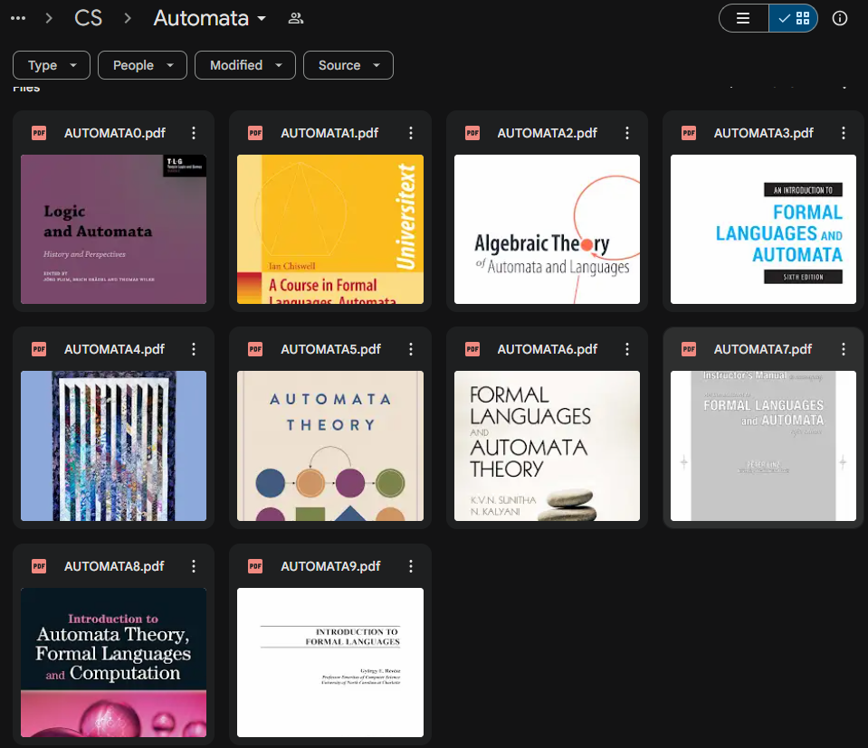
Dataset Collection
We collected freely accessible academic books in mathematics and computer science fields from the internet.
Each book was individually reviewed to ensure its relevance and suitability for our research objectives.
Our dataset includes both original PDFs and scanned PDFs (images of book pages rather than embedded text)
Mathematics | Computer Science
Linear Algebra | Data structures and Algorithms
Abstract Algebra | Object Oriented Programming
Calculus | Functional Programming
Combinatorics | Operation Systems
Probability | Compilation
Logic | Automata and Formal Languages
Set theory | -
Notes:
We collected freely accessible academic books in mathematics and computer science fields from the internet.
Each book was individually reviewed to ensure its relevance and suitability for our research objectives.
Our dataset includes both original PDFs and scanned PDFs (images of book pages rather than embedded text)

Slide 10
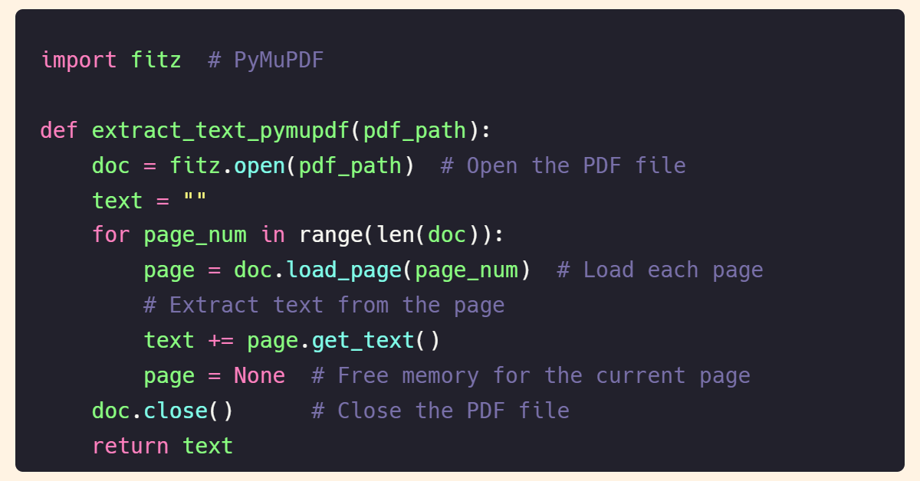
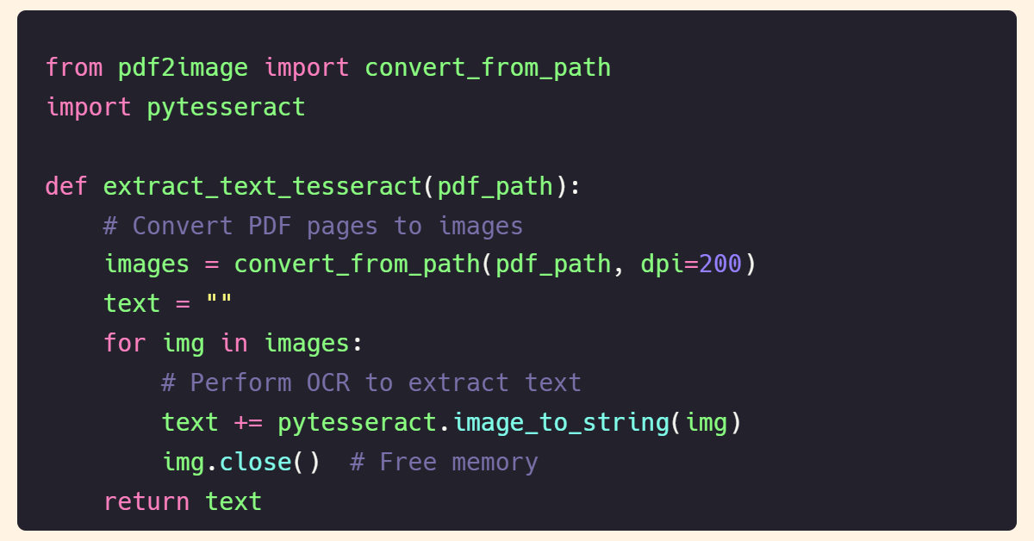
Dataset Collection
Text Extraction Techniques:
For original PDFs, we used tools like PyMuPDF (Fitz) to handle complex PDF structures.
For scanned PDFs, we applied Tesseract OCR to convert image-based pages into machine-readable text.
fitz.open() opens the PDF file
load_page() loads each page to process
get_text() extracts the actual text from the page
convert_from_path() converts each page of the scanned PDF into an image
image_to_string() performs OCR to extract readable text from the image
Notes:
Before starting the project, we tested different algorithms for text extraction techniques to find a fast and reliable solution. We found that PyMuPDF and Tesseract OCR were sufficient for our purposes.

Slide 11
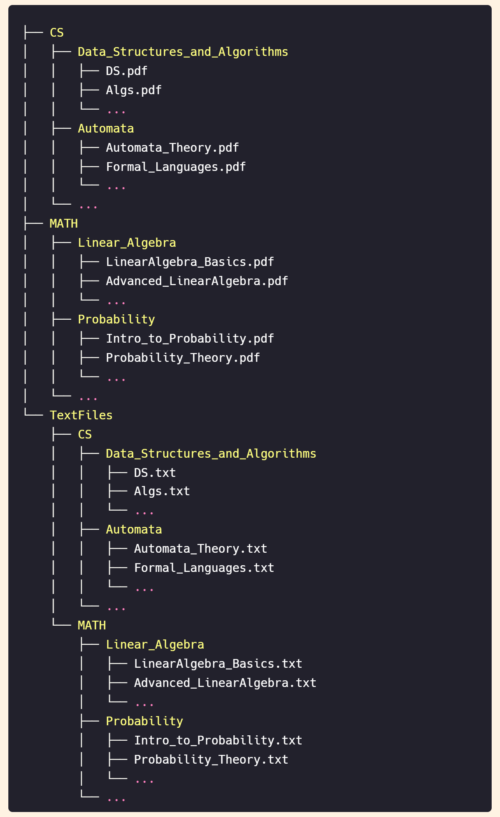
Dataset Collection
We collected ~ 140 academic books
~80% processed with PyMuPDF
~20% processed with Tesseract OCR
Notes:
We collected around 140 academic books, with approximately 80% processed using PyMuPDF and 20% processed using Tesseract OCR.

Slide 12
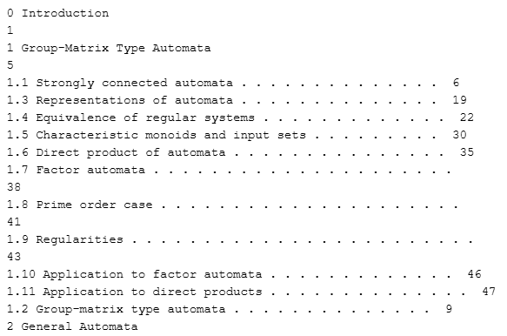
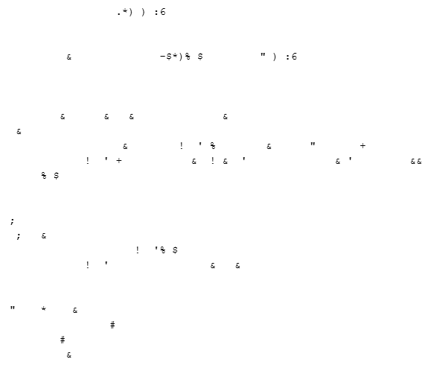
Text Preprocessing
1. Removing Irrelevant Content
We performed manual review across all books because the PDF-to-text conversion process may introduce artifacts into the extracted text, which required manual verification to prevent corrupted data from being included in the final dataset.
Additionally, we eliminated sections not directly related to the subject matter, such as bibliographies, tables of contents, and indices.
Notes:
Preprocessing was a crucial step. First, we removed irrelevant content like tables of contents, bibliographies, and indices.

Slide 13
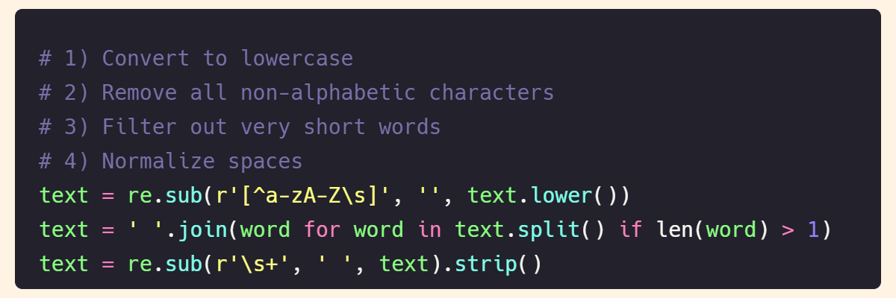
Text Preprocessing
2. Standardizing Text
We converted all characters to lowercase to maintain consistency.
Additionally, we removed punctuation marks, extra whitespace, and numerical values to retain only alphabetic characters and spaces, ensuring the text was clean and uniform for further processing.
Notes:
Next, we standardized the text—converting everything to lowercase, removing punctuation, and eliminating numbers. This helped focus on the language patterns without distractions.

Slide 14
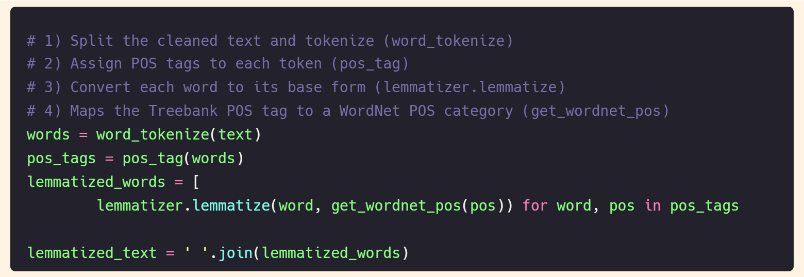
Text Preprocessing
3. Linguistic Normalization
We applied NLP technique using NLTK for lemmatization.
Lemmatization: Reduced words to their dictionary form using vocabulary and morphological analysis.
This process helped in reducing words to their root forms and standardizing different word variations, improving the consistency of the dataset.
*
algorithms → algorithm
optimizing → optimize
processes → process
Notes:
We also applied lemmatization using NLTK, reducing words to their base form. For example, "optimizing" becomes "optimize," which helps the model see different forms of a word as the same.

Slide 15
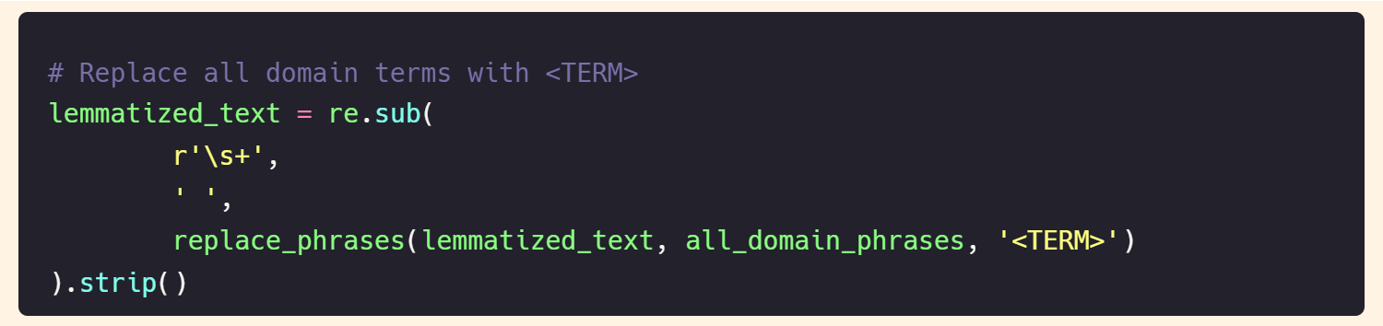
Text Preprocessing
4. Dictionary of Subject-Specific Terms
We identified and removed domain-specific terms from the dataset to ensure the texts were devoid of subject-specific language.
To achieve this, we created a dictionary containing one-word, two-word, and three-word phrases commonly found in mathematical and computer science texts.
Instead of deleting these terms, we replaced them with the tag <TERM> to maintain the syntactic structure of the sentences and provide consistency in the text. This approach prevented disruptions in sentence flow while focusing on the underlying metalanguage.
Notes:
To ensure we weren’t relying on domain-specific terms, we replaced technical words with a tag. This allowed us to maintain sentence structure while focusing on the underlying language.

Slide 16
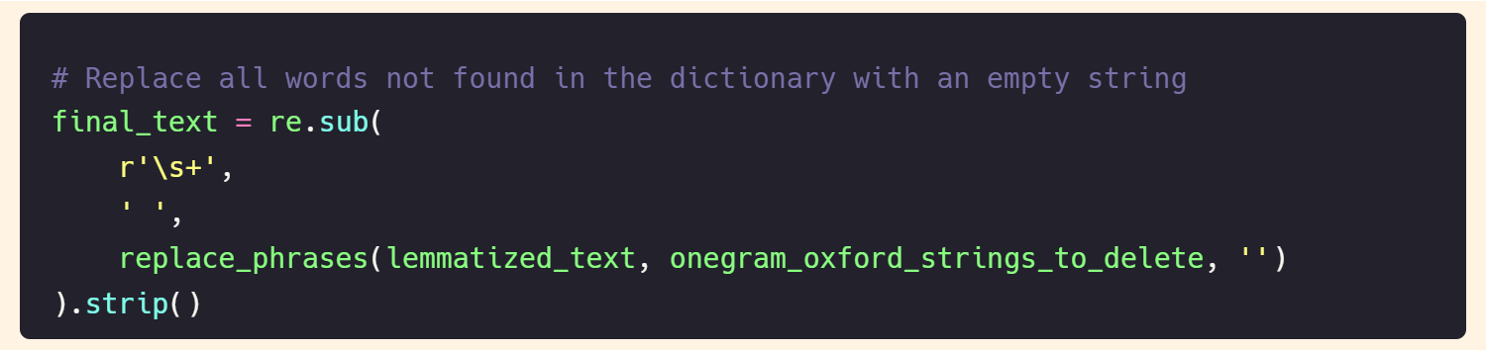
Text Preprocessing
5. Filtering Non-English Words
We filtered out words that are not recognized as English words by cross-referencing them with the Oxford Dictionary.
This process ensured that non-existent or irrelevant words were removed from the dataset, improving the quality of the text for further analysis.
Notes:
We filtered out words that are not recognized as English words by cross-referencing them with the Oxford Dictionary. This ensured that non-existent or irrelevant words were removed, improving the quality of the text for further analysis.

Slide 17
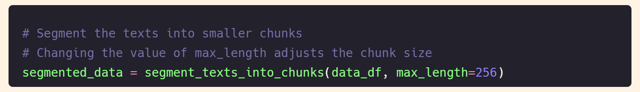
Text Preprocessing
6. Text Segmentation
We divided the preprocessed text into chunks of varying sizes to serve as input for the deep learning models.
We experimented with different segment sizes to determine which configuration provides the most accurate classification results.
* This code splits the text into chunks with a maximum length of 256 tokens, which we found effective for the model.
Notes:
After preprocessing, we performed text segmentation, dividing the preprocessed text into chunks of varying sizes to serve as input for the deep learning models. We experimented with different segment sizes to determine which configuration provided the most accurate classification results.

Slide 18
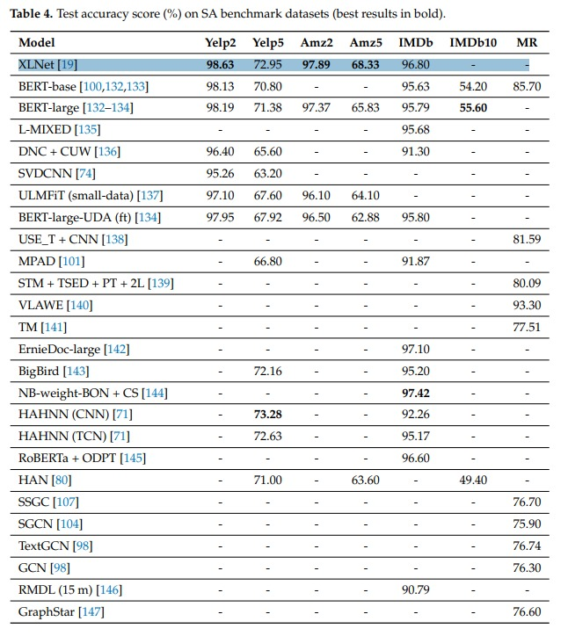
Text Classification
Multiple studies and benchmarks have consistently ranked XLNet among the top-performing models for text classification tasks due to its exceptional accuracy and robustness.
XLNet effectively captures complex language patterns, making it ideal for analyzing texts even after removing specialized vocabulary.
Its ability to model bidirectional contexts allows XLNet to understand the subtle nuances in language essential for our project's focus on metalanguage.
Notes:
For classification, we chose XLNet, a state-of-the-art language model known for capturing complex patterns in text. Unlike traditional models, XLNet looks at text from all possible angles, not just left-to-right, making it great for understanding context.

Slide 19
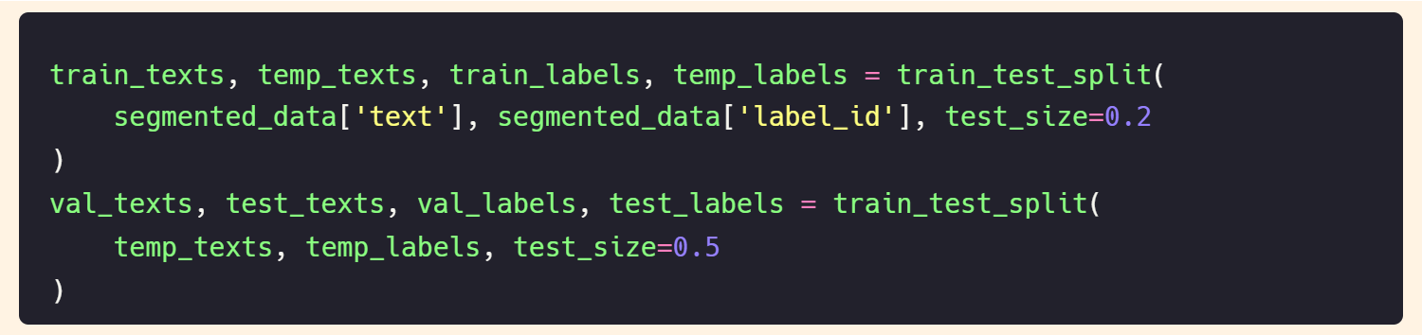
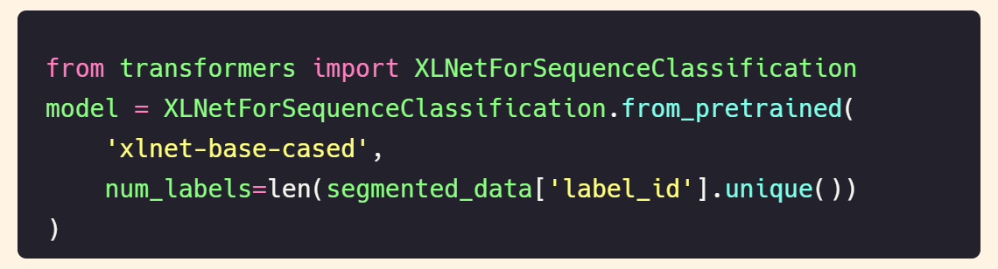
Text Classification
Data Splitting
The dataset was split into three subsets:
Training Set (80%)
Validation Set (10%)
Test Set (10%)
Model Initialization
We initialized the pre-trained XLNet model using the xlnet-base-cased architecture, which was fine-tuned on our dataset.
The model was trained to classify texts into their respective fields based on metalanguage patterns.
Notes:
We used XLNetForSequenceClassification, leveraging a pre-trained version that we fine-tuned on our dataset.
We split our data into training (80%), validation (10%), and test (10%) sets to ensure robust results.

Slide 20
Text Clustering
We used clustering techniques to validate the classification results from XLNet and to explore relationships between different fields based on their linguistic patterns.
Clustering Techniques Employed
K-Means Clustering | Partitioning Around Medoids (PAM)
Density-Based Clustering | Gaussian Mixture Models (GMMs)
For each clustering algorithm, we tested different parameter configurations and identified the best settings to achieve the highest clustering quality.
Notes:
To validate our classification, we applied different clustering algorithms. Clustering helps us see if texts naturally group together based on their linguistic patterns, without supervision.

Slide 21
3. Results & Insights

Slide 22
What was expected

Slide 23
the Model
If the model achieves very high accuracy, for example, over 85%
The metalanguages of each field are quite unique, showing little similarity between them
Might indicate potential issues with our data or model
If the model achieves low accuracy
The metalanguages of different fields are so similar that the model struggles to distinguish between them
Might indicate potential issues with our data or model
Notes:
We initially expected our model to achieve around 85% accuracy, assuming strong metalanguage differences between Math and CS.

Slide 24
Clustering
If the model achieves very high accuracy, for example, over 85%
Each cluster will contain texts from only one specific field, reflecting distinct linguistic patterns
If the model achieves low accuracy
Each cluster contains texts from multiple fields, suggesting that the metalanguages across these fields are too similar
Notes:
If clustering aligns with our classification results, it strengthens our findings. For example, if Math texts form one cluster and CS texts form another, it suggests distinct metalanguages
Let’s see how our actual results compared to these expectations.

Slide 25
What we achieved

Slide 26
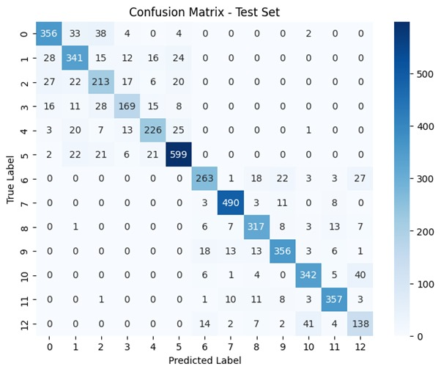
the Model
After training our XLNet model, we achieved an accuracy of 83% in classifying texts from Mathematics and Computer Science even after domain-specific terminology was removed.
Distinct Metalanguages: The confusion matrix shows that the model reliably distinguishes Mathematics from Computer Science, suggesting each field possesses its own linguistic structure and reasoning style.
Subfield Overlaps: Within each field, closely related subfields were harder to differentiate, implying they share enough structural and linguistic patterns to blur boundaries.
Taken together, these findings indicate no guaranteed correlation between proficiency in Mathematics and Computer Science—each discipline demands its own cognitive and linguistic framework. However, within a single field, excelling in one subfield often makes it easier to succeed in another, due to common language features and approaches.
Notes:
After training, XLNet achieved an accuracy of 83%, which is close to our target. The confusion matrix shows that the model distinguishes well between Math and CS but struggles a bit within subfields.

Slide 27
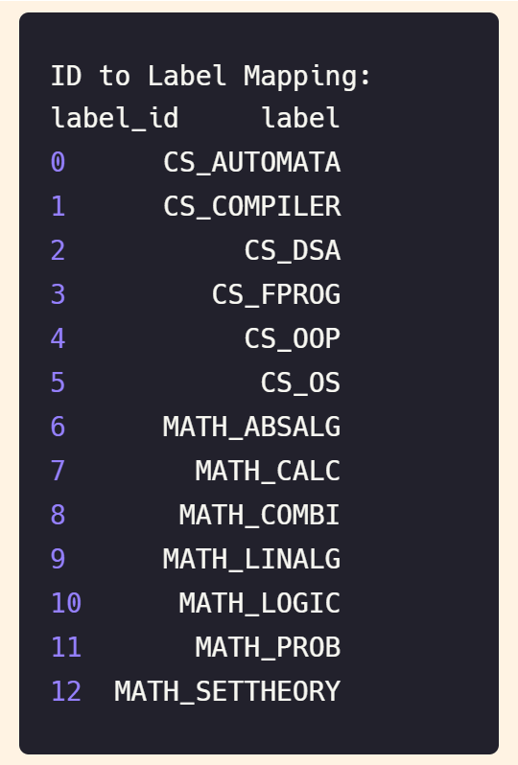
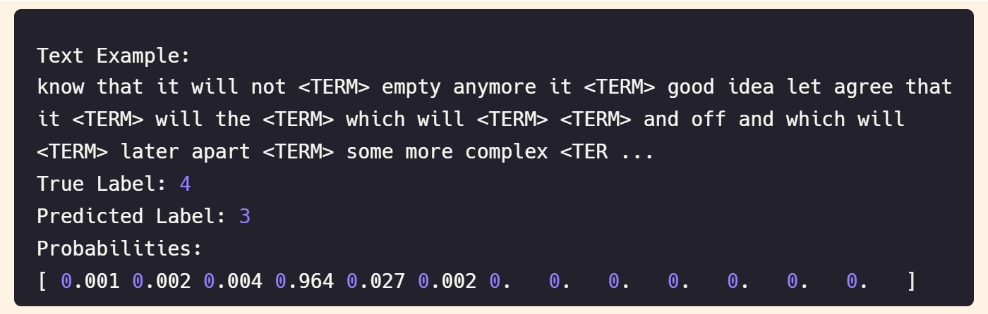
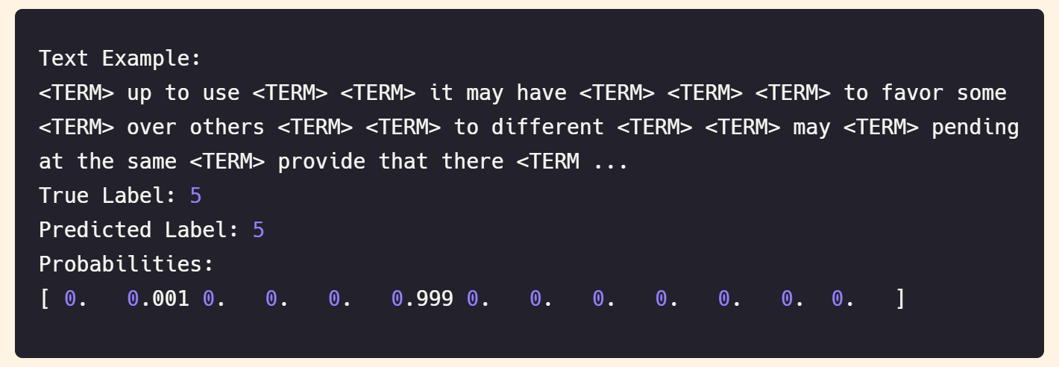
Notes:
This aligns with real life—students often find Math and CS distinctly challenging. However, within each subject, subfields can share overlapping language, making them harder to differentiate.

Slide 28
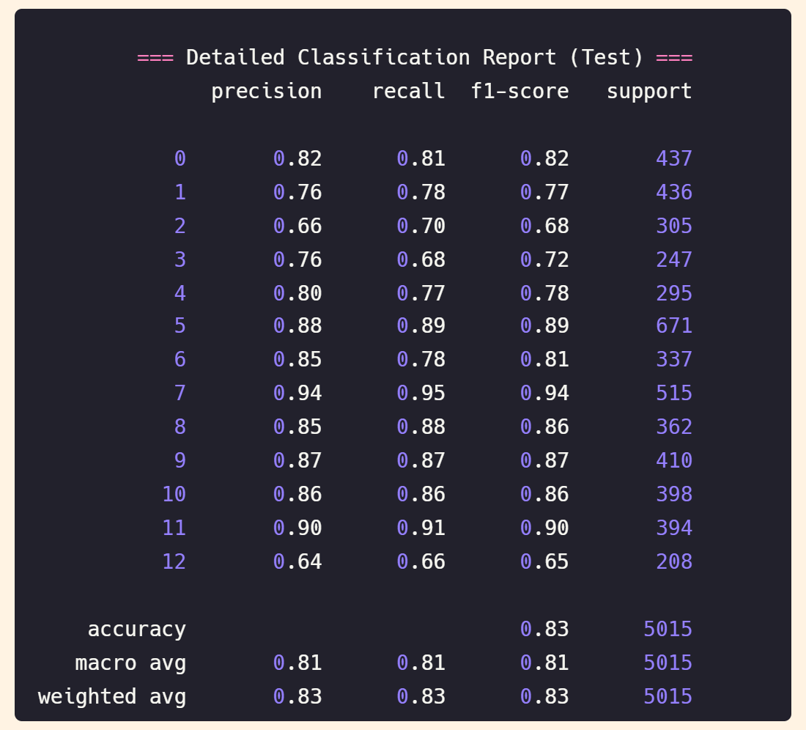
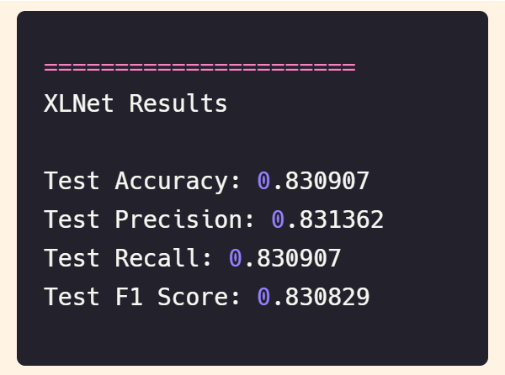
We achieved strong performance on the test set:
The model performed particularly well in classes 5, 7, 8, 9, 10, and 11, with F1 scores above 0.85, indicating strong predictive accuracy in these categories.
The model struggled more with classes 2, 3, and 12, where F1 scores dropped below 0.70, suggesting overlapping metalanguage patterns.

Slide 29
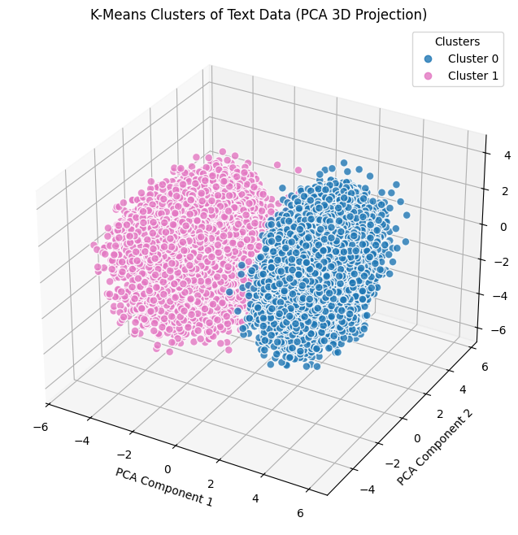
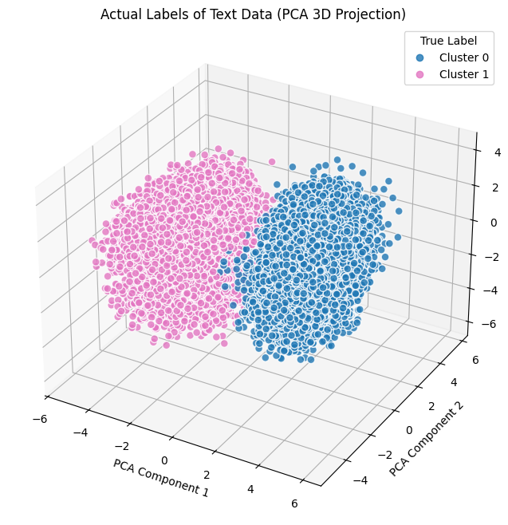
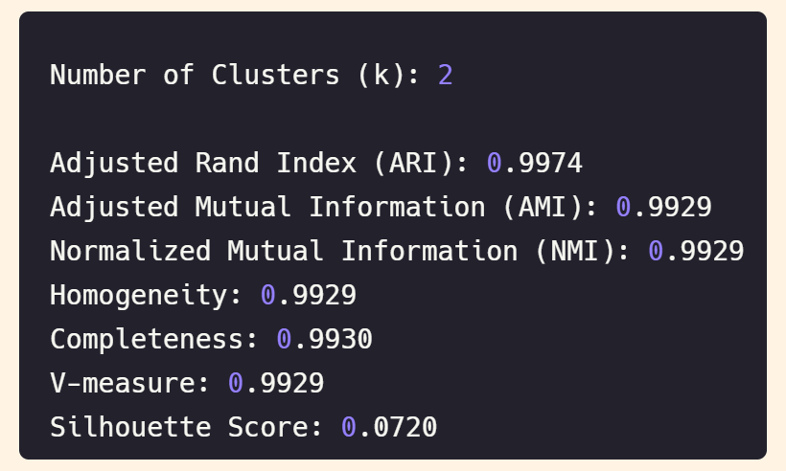
Clustering by K-Means
Notes:
Our clustering results with K-Means and GMM confirmed this. While Math and CS texts formed distinct clusters, subfields showed some overlap, reflecting shared linguistic structures.

Slide 30
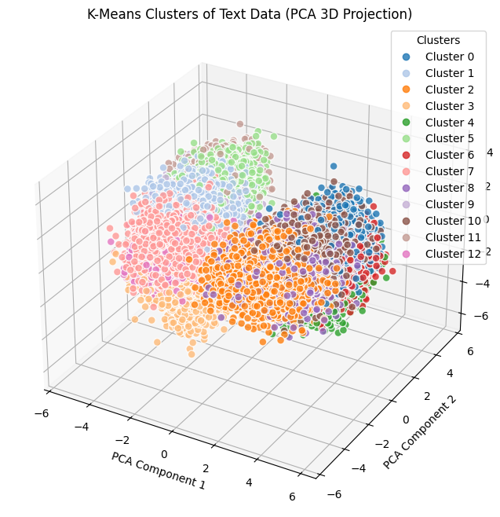
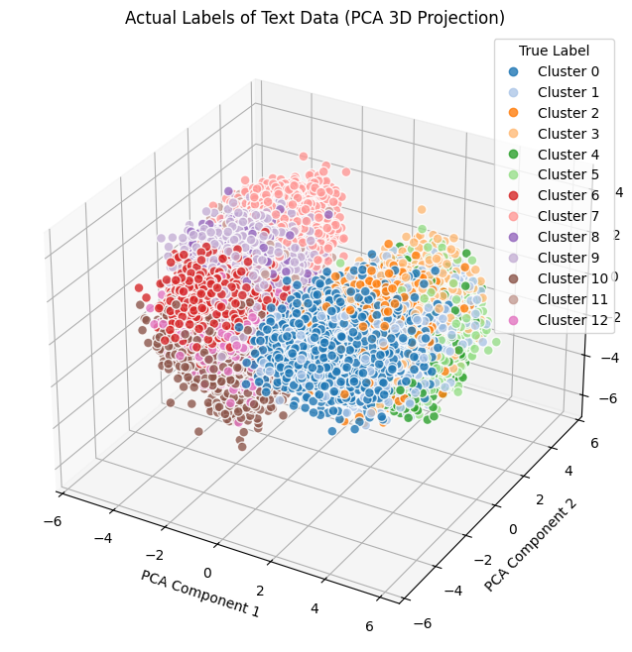
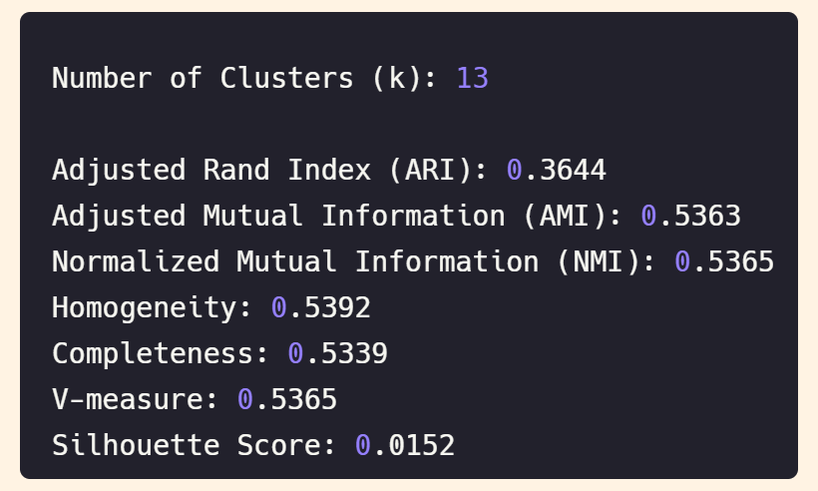
Clustering by K-Means

Slide 31
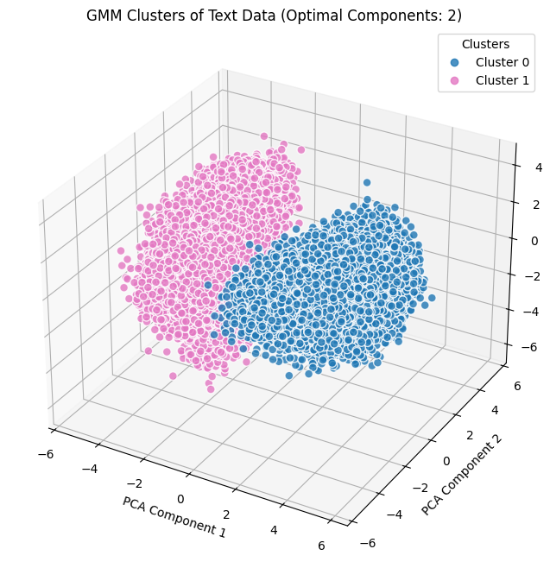
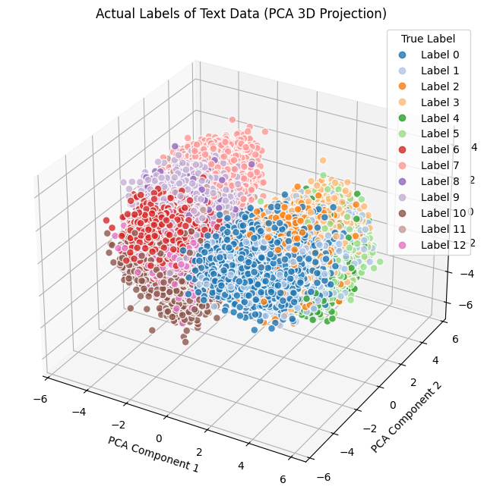
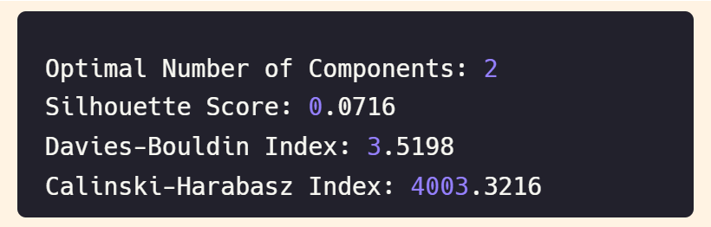
Clustering by GMM

Slide 32
4. Challenges & Future Work

Slide 33

Challenges
Data Collection Difficulties:
Finding free-access books in the right PDF format (non-scanned) or txt format was challenging.
Books needed to contain only clean theory, without formulas or code, to ensure dataset relevance. Excluding formulas and code significantly reduced the dataset size, requiring more books to compensate.
PDF-to-Text Conversion Issues:
Artifacts introduced during PDF-to-text conversion due to limitations in current algorithms.
Identifying Subject-Specific Terms:
The biggest challenge was deciding which words are terms and which are not.
Example: In OOP texts, the word "for" can be a programming term (loop) or just part of regular language (e.g., "for example").
Notes:
We faced several challenges, like finding high-quality academic books without formulas or code. PDF-to-text conversion was tricky, often introducing artifacts.
Another major challenge was deciding which words are terms. For example, "for" can be a programming term in loops or just a common word in "for example."

Slide 34

Future Work
Context-Aware Term Identification Model:
Develop a model to identify terms based on context, distinguishing between technical terms and common language.
Automated Relevance Detection:
Implement an algorithm to automatically detect relevant sections of PDFs before conversion.
Alternatively, design a model to analyze text files and filter out irrelevant content post-conversion.
Notes:
For future work, we can think about of developing a model to identify terms based on context and improve automated relevance detection in texts.

Slide 35

Questions?
We presented our methodology to classify mathematics and computer science fields based on their metalanguages.
04/02/2025
Notes:
In conclusion, our project shows that Math and CS have distinct metalanguages, which may explain why students excel differently in these fields. However, subfields often overlap linguistically, making classification more challenging.
This research opens the door for more personalized educational tools, helping adapt learning materials to students’ language preferences.

